Slide 1
Sprint Review: Salesforce BAU
Sprint 16
15th September – 12th October

Slide 2




Sprint Overview
Sprint Numbers
Sprint Links
Key Dates
Weeks
4
Sprint work Items Delivered
Enhancement Testing
6 – 10 September
Work Items Delivered
9
BAU Go Live
13th October
UAT Items Addressed
0
Story Points Completed
14

Slide 3
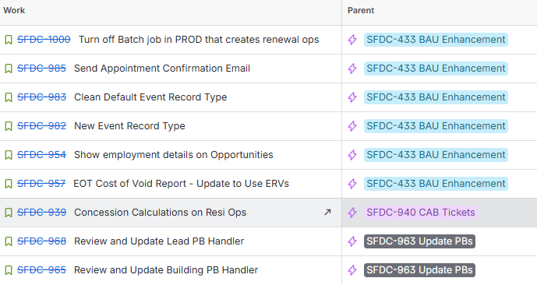
Work Items Delivered

Slide 4
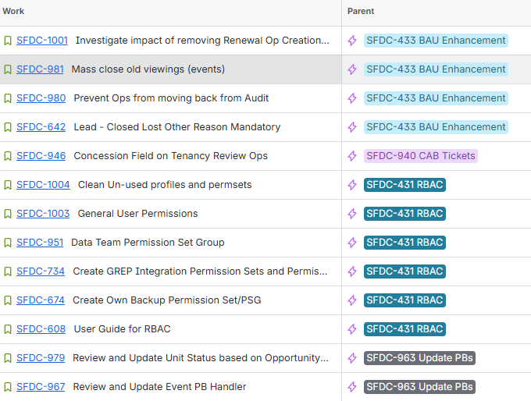
Work Items Planned for Next Sprint

Slide 5
General Items
Items Carried over to next Sprint | Reasons
SFDC-979: Review and Update Unit Status based on Opportunity Status | UAT not completed in time – lack of availability of end users
Risk | Contributing factors | Impact | Decisions taken
None
Issue | Contributing factors | Impact | Decisions taken
reCAPTCHA on Form Assembly forms impacting form performance |  | Alters how the form can be submitted, with conditional formatting and date inputs not displaying correctly | Hold off on release of SFDC-834. SFDC-863, and SFDC-865
Decision | Description | Date

Slide 6

Thank You

